Slide 1
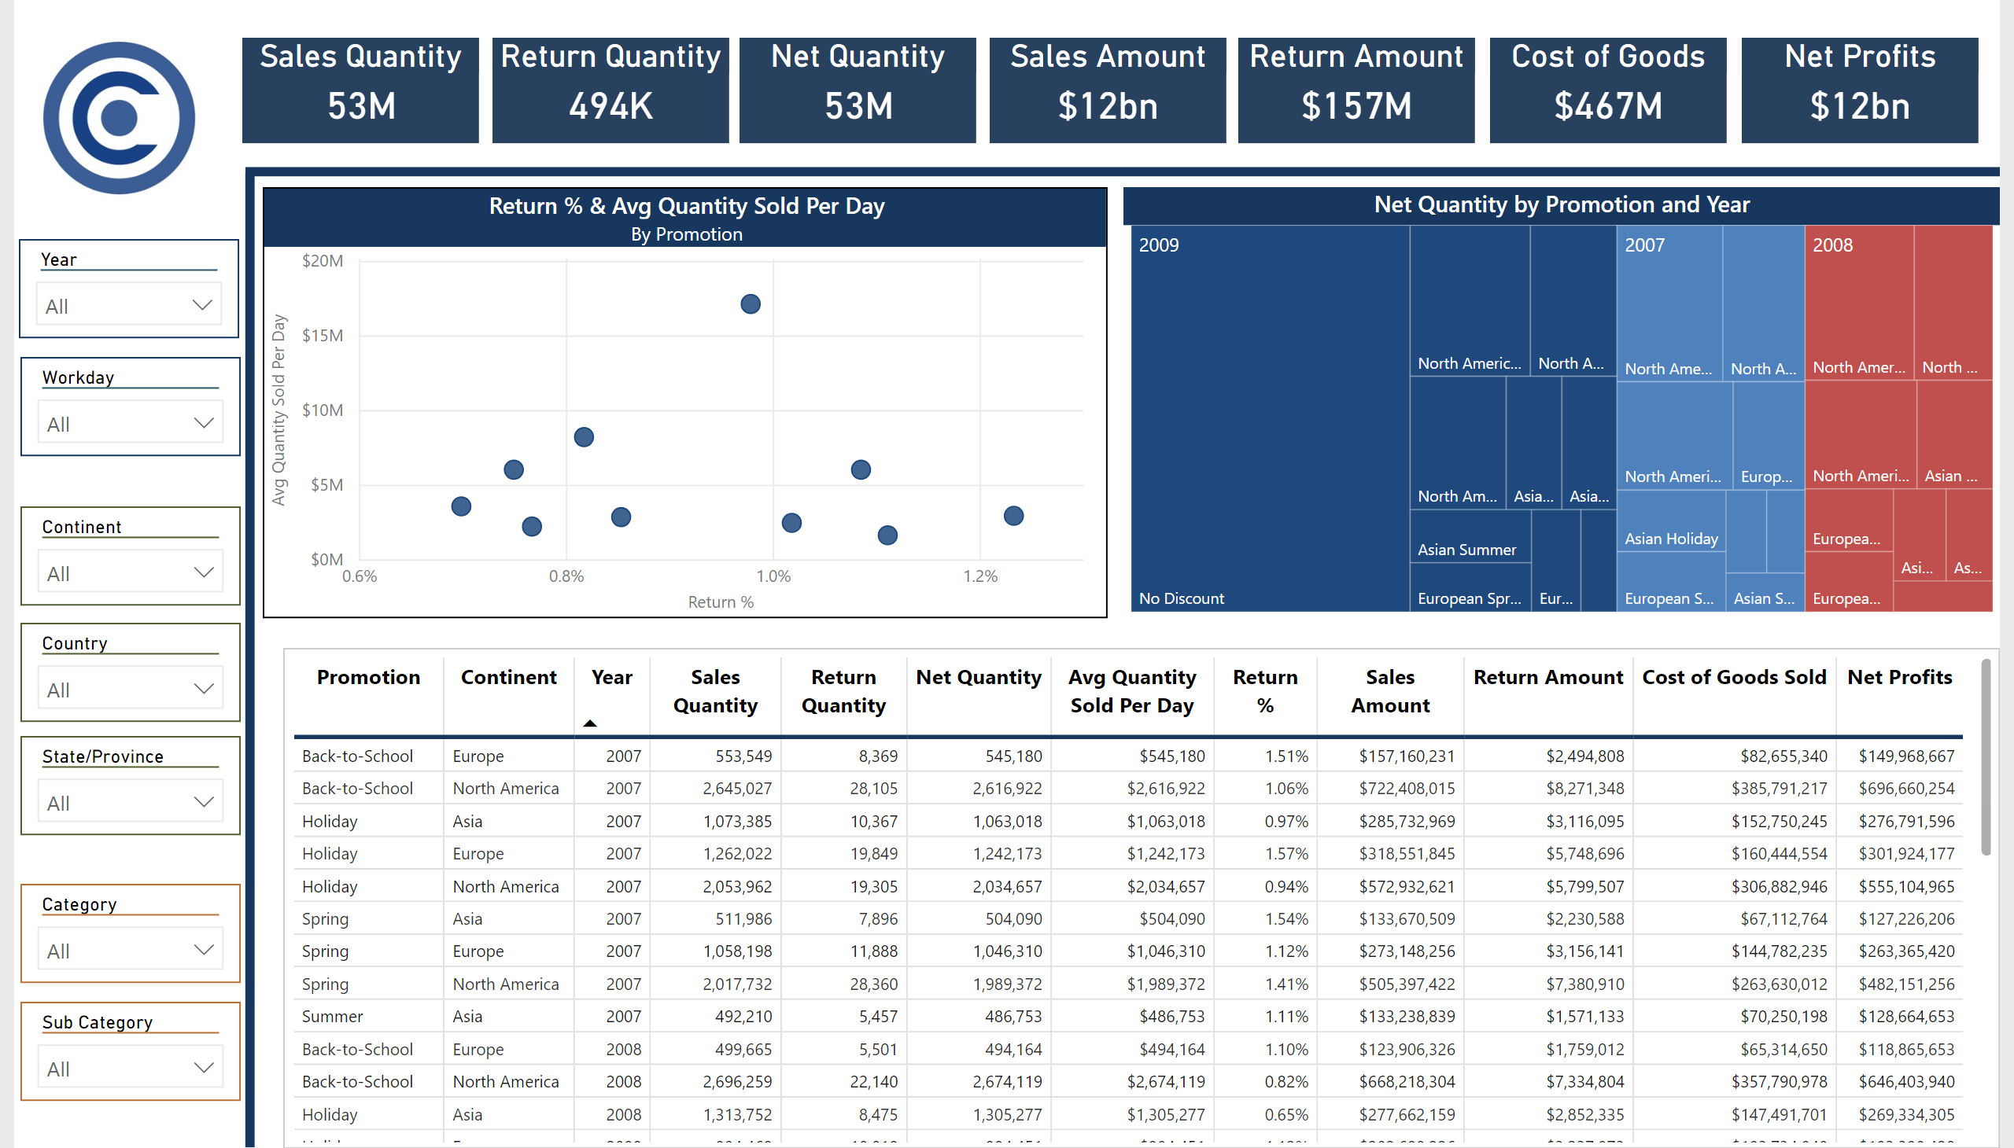
Promotion Analysis
Notes:
image
No alt text provided
shape
No alt text provided
shape
No alt text provided
Sales Quantity
No alt text provided
Return Quantity
No alt text provided
Net Quantity
No alt text provided
Sales Amount
No alt text provided
Return Amount
No alt text provided
Cost of Goods
No alt text provided
Net Profits
No alt text provided
slicer
No alt text provided
slicer
No alt text provided
slicer
No alt text provided
slicer
No alt text provided
slicer
No alt text provided
tableEx
No alt text provided
slicer
No alt text provided
slicer
No alt text provided
Net Quantity by Promotion and Year
No alt text provided
Return % & Avg Quantity Sold Per Day
No alt text provided

Slide 2
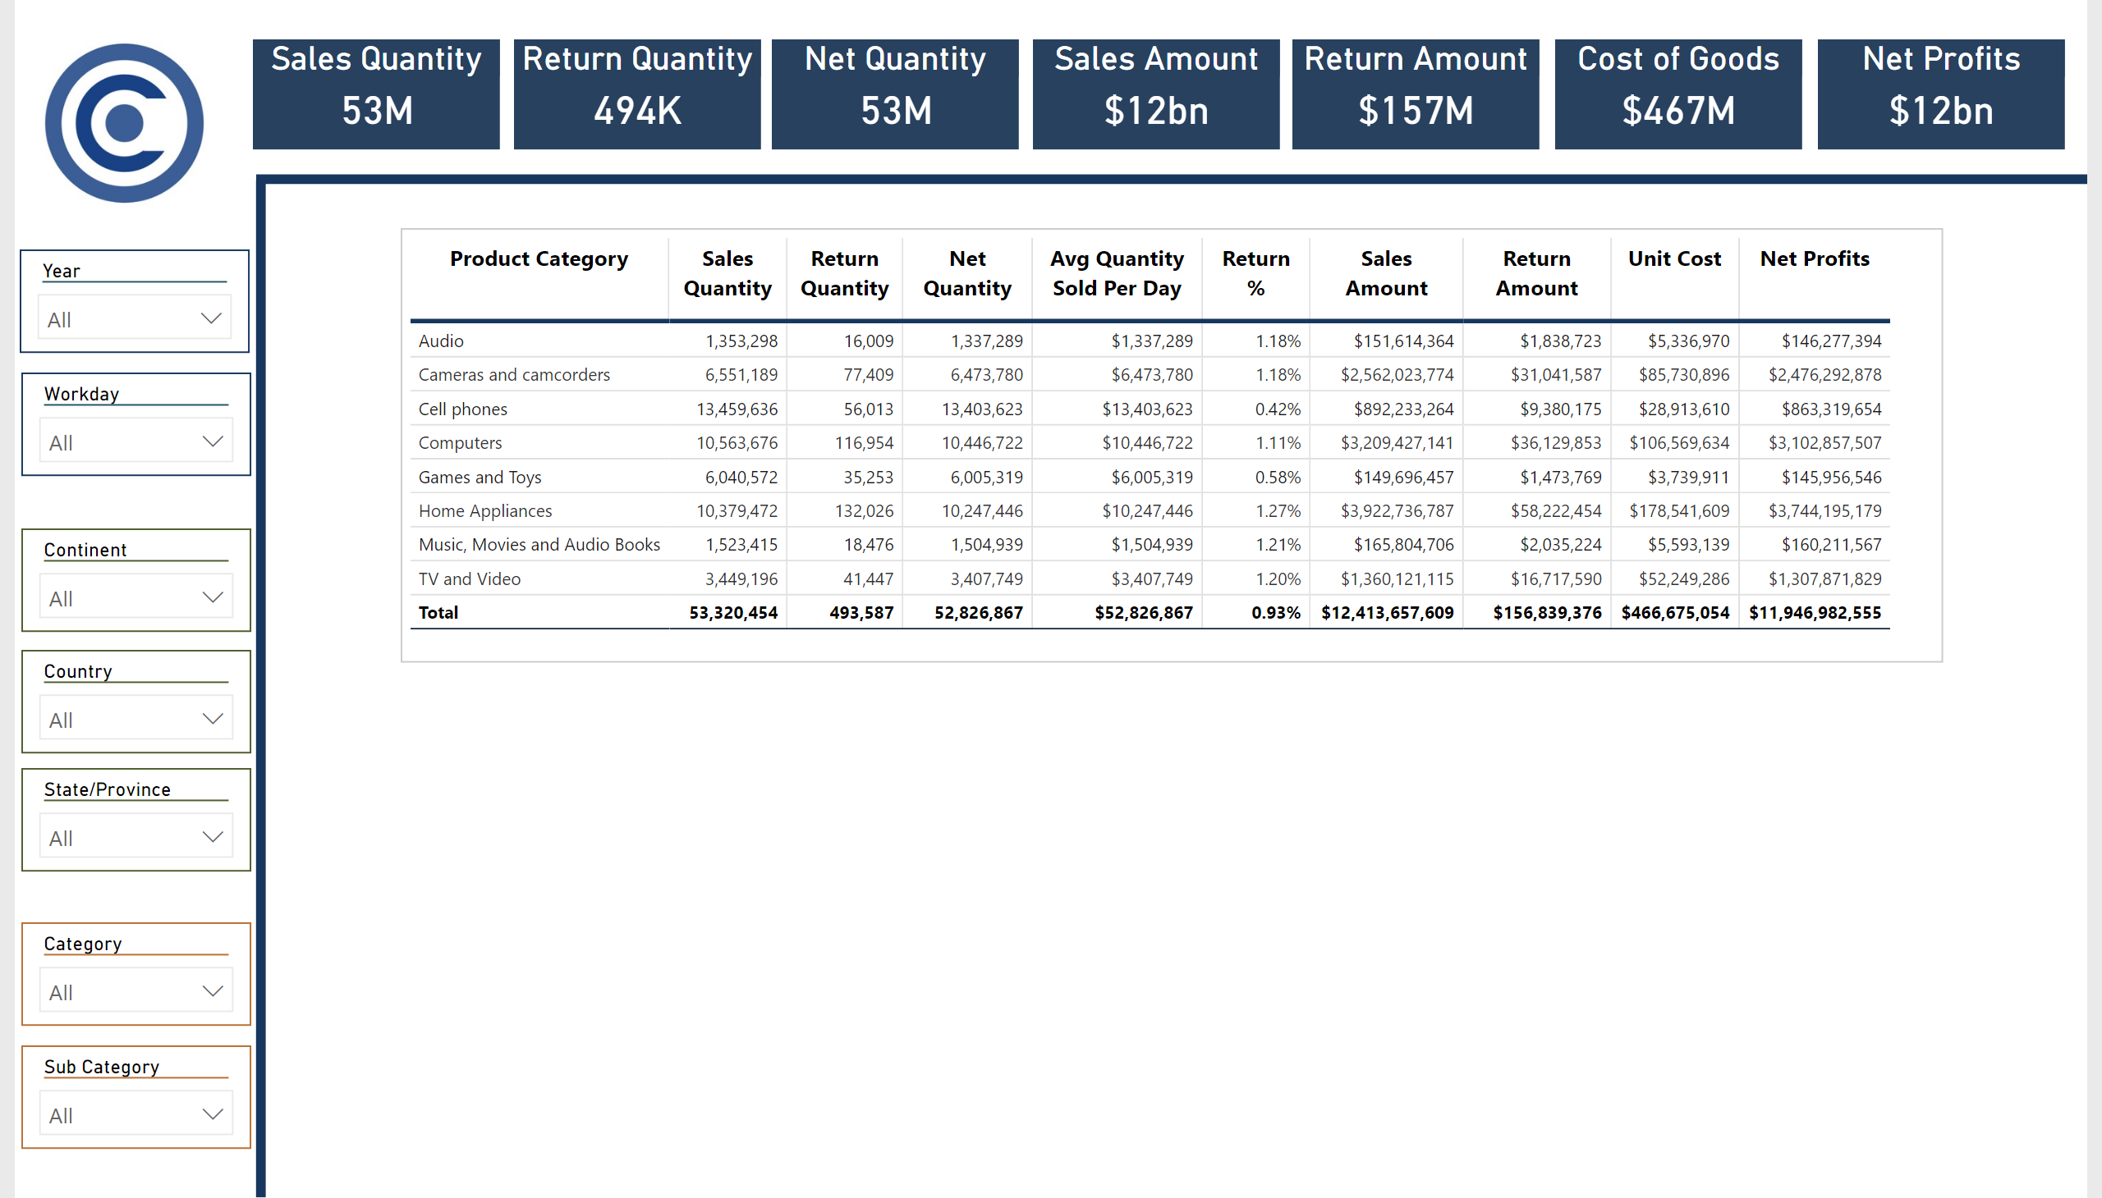
Product Details
Notes:
image
No alt text provided
shape
No alt text provided
shape
No alt text provided
Sales Quantity
No alt text provided
Return Quantity
No alt text provided
Net Quantity
No alt text provided
Sales Amount
No alt text provided
Return Amount
No alt text provided
Cost of Goods
No alt text provided
Net Profits
No alt text provided
slicer
No alt text provided
slicer
No alt text provided
slicer
No alt text provided
slicer
No alt text provided
slicer
No alt text provided
slicer
No alt text provided
slicer
No alt text provided
pivotTable
No alt text provided

Slide 3
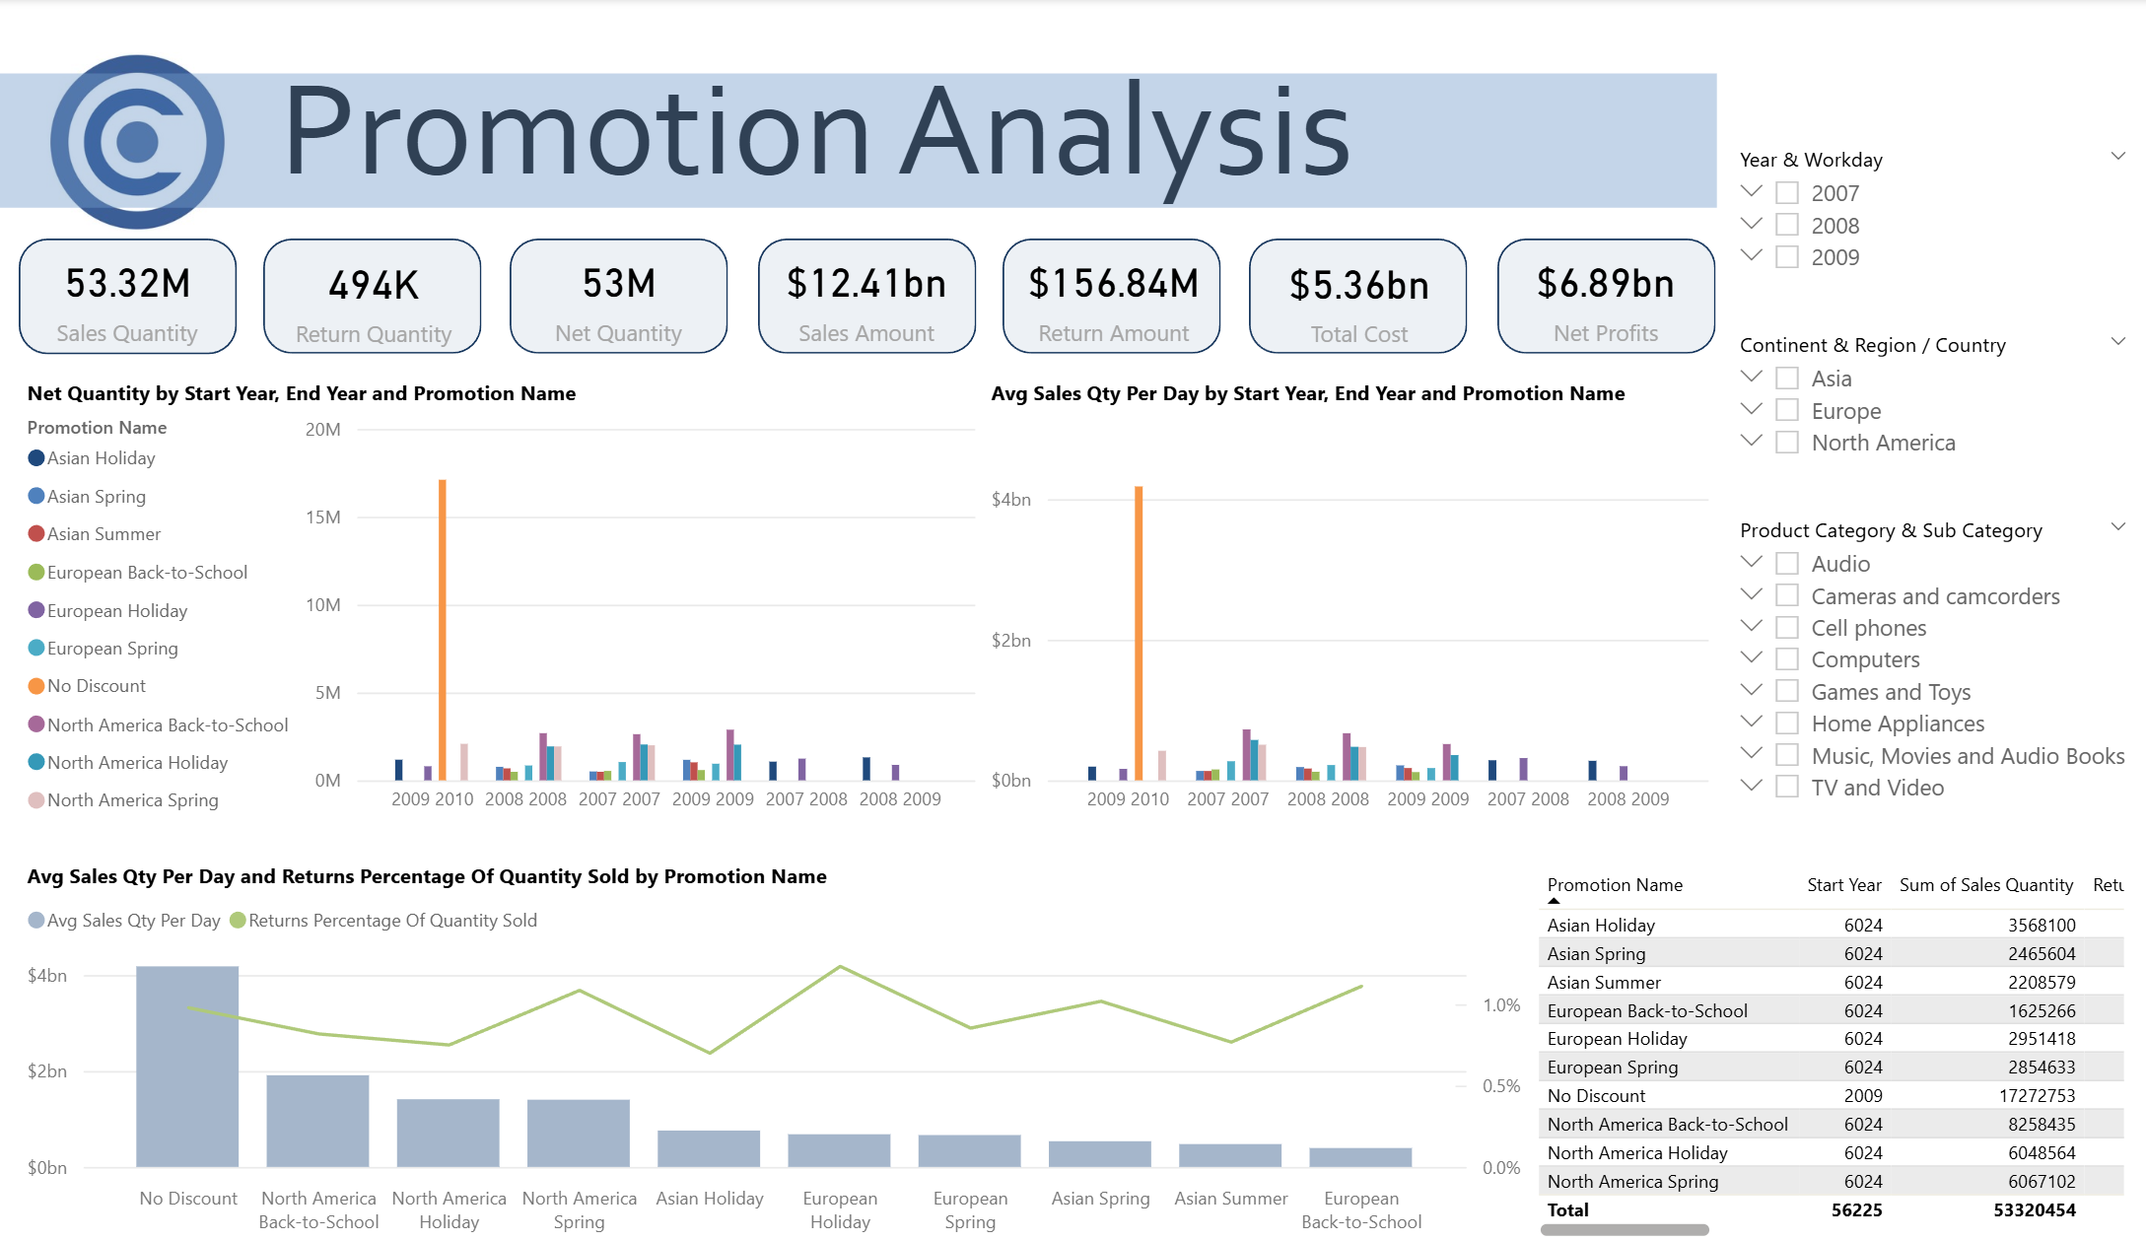

Slide 4
